Slide 1
Car Sales Trend Analysis
Team DS7
Aloysius Felix Rozario
Inna Semenykhina
Nguyen Thuy Duong Le
Shailesh Thapa
Notes:
Hello everyone.
We’re Team DS7 from the University of Toronto’s Data Science Certificate program. Today, we’ll share key findings from our capstone project analyzing car sales data from 2022 and 2023.

Slide 2
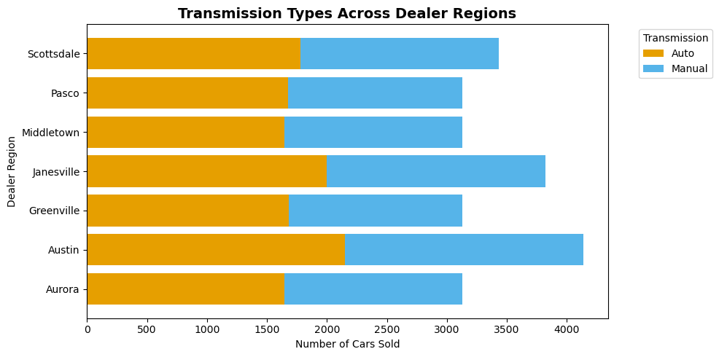
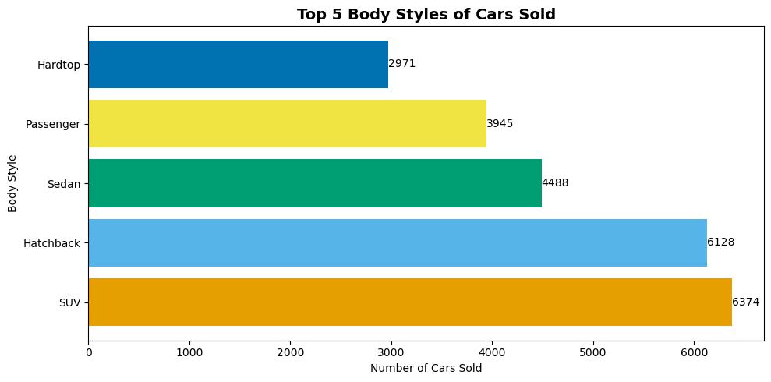
Objectives
Our goal was to uncover meaningful insights from the car sales data, using data cleaning, exploratory data analysis, and machine learning models.
We wanted to answer three main questions:
What types of cars are most popular?
Which customer segments buy which types of cars?
Can we predict future sales trends reliably?
Notes:
The three big questions that guided our entire project.
First, we examined car popularity across brands and body styles.
Next, we explored how customer traits like income or location affect car preferences.
Finally, we challenged ourselves to build a model that could actually predict future trends.
These goals gave us a clear path from raw data to actionable insights.

Slide 3
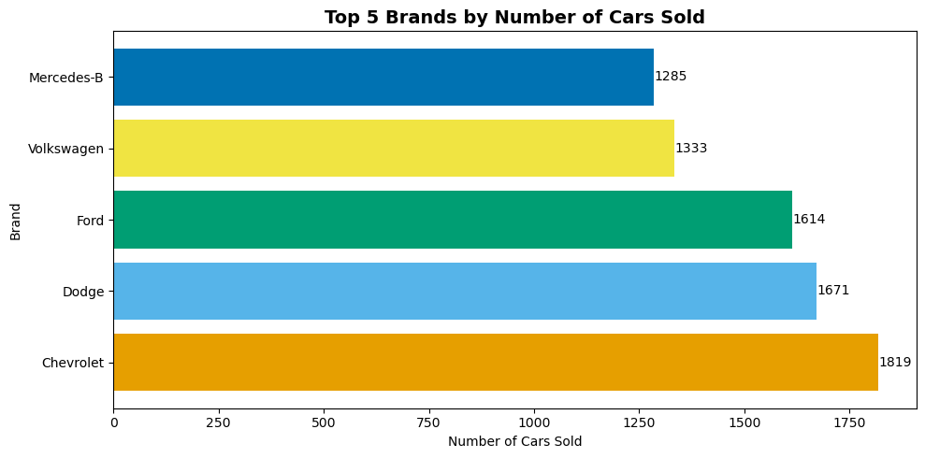
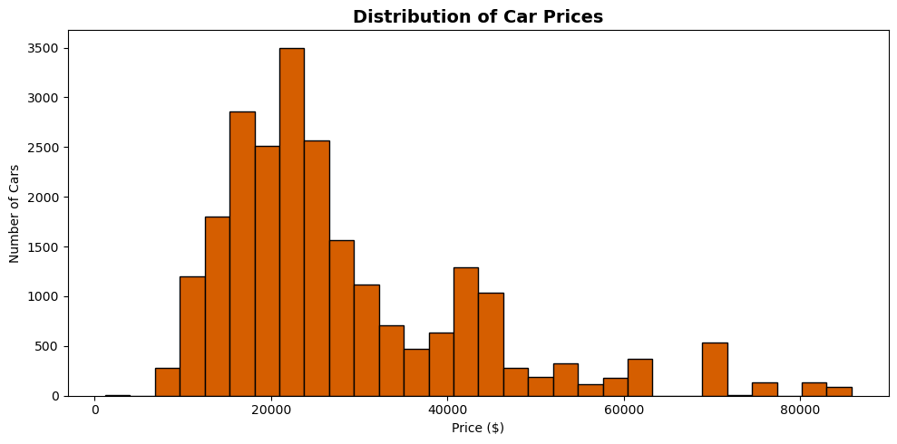
Data Key Insights
SUVs and Hatchbacks dominate – especially in mid to high income segments.
Automatic transmissions dominate across all regions.
Car price strongly correlates with customer income – higher income, higher price.
Some models like Hardtop and Passenger underperform and may need to be re-evaluated.
Notes:
Some of the most meaningful insights we discovered from the data.
First, SUVs and Hatchbacks clearly lead the market, especially among customers with mid to high incomes.
Automatic transmissions are strongly preferred, regardless of region, showing a universal customer trend.
When we looked at the top-selling brands, we found Chevrolet, Dodge, Ford, at the top.
Interestingly, there's a strong correlation between customer income and the price of the car they purchase — higher income customers tend to buy more expensive models.
Finally, not all models performed equally — we noticed that models like the Hardtop and Passenger vehicles had significantly lower sales, which could suggest a need for product review or marketing adjustment.

Slide 4
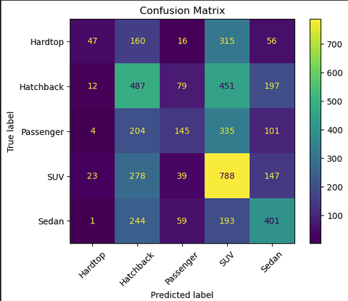
Methods - Logistic Regression
Classified car types using structured features (Company, Price, Transmission, etc.)
Model Accuracy: 39%, best F1 scores for SUV and Sedan
Logistic regression was limited by class overlap and feature sparsity

Slide 5
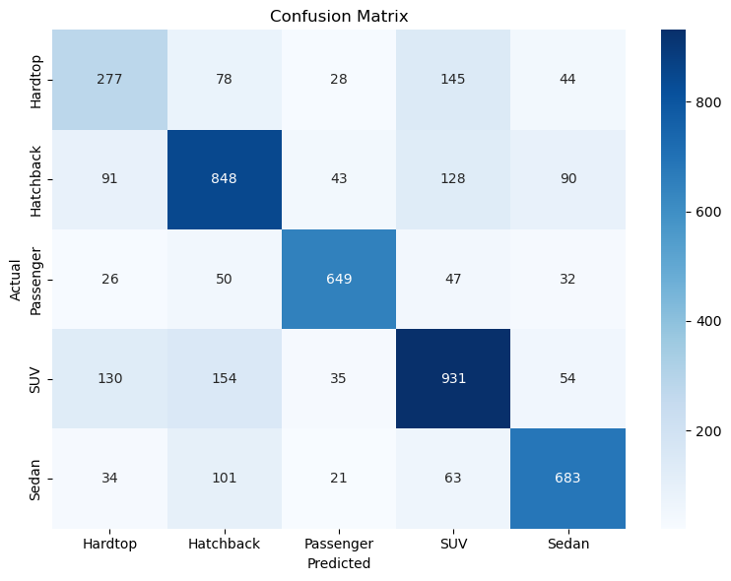
Methods - Random Forest Classifier
Type: Ensemble learning algorithm that builds multiple decision trees
Model non-linear relationships between features
Strength: Performance & Complexity (Ave Accuracy: 71%)
Trade-off: Interpretability
The model is promising and valuable as a decision-support tool. Continuous improvement is critical.
Notes:
Performance & Complexity: Random Forest typically achieves higher predictive accuracy in many real-world scenarios, particularly with diverse and complex datasets, by averaging the predictions of multiple decision trees.
Interpretability: Random Forest, while powerful, is a "black box" model, making it harder to understand the exact contribution of individual features.
While the model is promising (71% overall accuracy, strong for Passenger category), its performance varies across classes, making it valuable as a decision-support tool but not yet a fully autonomous system. Continuous improvement is needed in expanding dataset and cross-department data collaboration to enrich model inputs and model maturity.

Slide 6
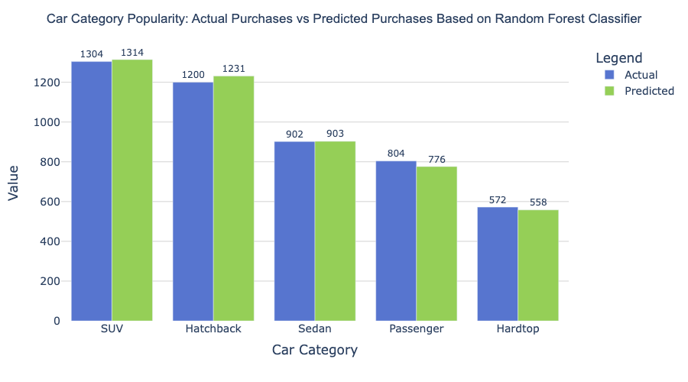
Car Sales Trend Based on Prediction
Notes:
The analysis shows that the most popular car categories are SUV and Hatchback with selling power of more than 1200 units overall with higher numbers in prediction.

Slide 7
Team-Specific Recommendations
Sales Team:
Focus inventory and promotions on SUVs, Hatchbacks and Passenger. And avoid overstocking niche models.
Marketing Team:
Run targeted campaigns emphasizing top categories.
Product Management:
Continue improving SUV models and revisit low-demand products.
Executives:
Reliable forecasts allow confident investment planning. Future enhancements can include additional features like marital status or end-owner details.
Notes:
Based on the results, we would like to share key takeaways for each team:
For Sales team: we recommend to prioritize SUV and Hatchback availability in key regions.
For Marketing team: we suggest designing targeted ads based on predicted category preference
For Product team: our recommendation would be to focus on improving models in high demand segment and revisit low-demand products
For Executive team: we suggest continue using prediction model to support quarterly sales targets and investment in high-demand segments, and also improving data quality for more detailed analysis.

Slide 8
Conclusion & Next Steps
In short, our data-driven approach can empower all stakeholders to make more accurate, confident decisions. Therefore, our next steps would be:
Predict “best-seller” car models.
Estimate car pricing based on detailed features.
Analyze popularity by region using deeper segmentation.
Notes:
In conclusion, we can say:
That the accuracy of the analysis results can empower all stakeholders with the essential decisions and business growth. This is why our next steps will be (dead from the slide)

Slide 9
Thank you for your attention!

